Slide 1
System Implementation

Slide 2
System Implementation and
Seven major activities
  Coding
  Testing
  Installation
  Documentation
  Training
  Support
Purpose
  To convert final physical system specifications into working and reliable software
  To document work that has been done
  To provide help for current and future users
17.<number>

Slide 3
The Process of Coding, Testing and Installation
Coding
  Physical design specifications are turned into working computer code
Testing
  Tests are performed using various strategies
  Testing can be performed in parallel with coding
Installation
  Process during which the current system is replaced by the new system
17.<number>

Slide 4
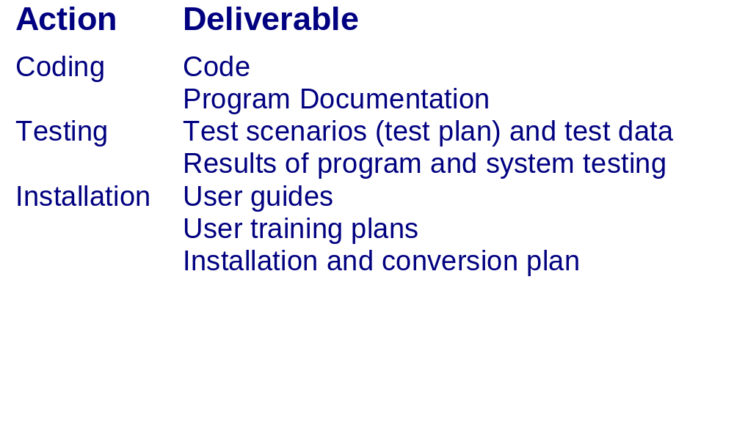
The Process of Coding,
Testing and Installation:
Deliverables
17.<number>

Slide 5
The Process of Documenting the System, Training Users and Supporting Users
Two audiences for documentation
  The information systems personnel who will maintain the system throughout its productive life
  The people who will use the system as part of their daily lives
Deliverables
  Documentation
    System documentation
    User documentation
  User training plan
    Classes
    Tutorials
  User training modules
    Training materials
    Computer-based training aids
  User support plan
    Help desk
    On-line help
    Bulletin boards and other support mechanisms
17.<number>

Slide 6
Software Application Testing
A test plan is developed during the analysis phase
During the design phase, a unit test plan and a system test plan are developed
The actual testing is done during implementation
Test plans provide improved communication among all parties involved in testing
  Serve as checklists
17.<number>

Slide 7
Software Application Testing
Types of Testing
Inspection
  A testing technique in which participants examine program code for predictable language-specific errors
Walkthrough
  A peer group review of any product created during the systems development process; also called a structured walkthrough
Desk Checking
  A testing technique in which the program code is sequentially executed manually by the reviewer
17.<number>

Slide 8
Software Application Testing
Types of Testing
Unit Testing
  Each module is tested alone in an attempt to discover any errors in its code, also called module testing
Integration Testing
  The process of bringing together all of the modules that a program comprises for testing purposes. Modules are typically integrated in a top-down, incremental fashion
17.<number>

Slide 9
Software Application Testing
Types of Testing
System Testing
  The bringing together of all the programs that a system comprises for testing purposes. Programs are typically integrated in a top-down, incremental fashion
Stub Testing
  A technique used in testing, especially where modules are written and tested in a top-down fashion, where a few lines of code are used to substituted for subordinate modules
17.<number>

Slide 10
Software Application Testing
The Testing Process
The purpose of the testing is confirming that the system satisfies requirements
Testing must be planned
Test Case
  A specific scenario of transactions, queries or navigation paths that represent a typical, critical or abnormal use of the system
  Test cases and results should be thoroughly documented so they can be repeated for each revision of an application
17.<number>

Slide 11
Software Application Testing eXtreme Programming
Coding and testing are intimately related parts of the same process
Code is written, integrated into system and then tested
Iterative process of testing, fixing bugs and re-testing
All coding is done by two people working together
17.<number>

Slide 12
Software Application Testing
Acceptance Testing by Users
The process whereby actual users test a completed information system, the end result of which is the users’ acceptance of it
Alpha Testing
  User testing of a completed information system using simulated data
  Recovery testing
    Forces the software (or environment) to fail in order to verify that recovery is properly performed
  Security testing
    Verifies that protection mechanisms built into the system will protect it from improper penetration
  Stress testing
    Tries to break the system
  Performance testing
    Determines how the system performs on the range of possible environments in which it may be used
17.<number>

Slide 13
Software Application Testing
Acceptance Testing by Users
Beta Testing
  User testing of a completed information system using real data in the real user environment
17.<number>

Slide 14
Installation
The organizational process of changing over from the current information system to a new one
Four approaches
  Direct Installation
    Changing over from the old information system to a new one by turning off the old system when the new one is turned on
  Parallel Installation
    Running the old information system and the new one at the same time until management decides the old system can be turned off
17.<number>

Slide 15
Installation
  Single location installation
    Trying out an information system at one site and using the experience to decide if and how the new system should be deployed throughout the organization
  Phased Installation
    Changing from the old information system to the new one incrementally, starting with one or a few functional components and then gradually extending the installation to cover the whole new system
17.<number>

Slide 16
Planning Installation
Considerations
  Data conversion
    Error correction
    Loading from current system
  Planned system shutdown
  Business cycle of organization
17.<number>

Slide 17
Documenting The System
System documentation
  Detailed information about a system’s design specifications, its internal workings and its functionality
  Internal documentation
    System documentation that is part of the program source code or is generated at compile time
  External documentation
    System documentation that includes the outcome of structured diagramming techniques such as data flow and entity-relationship diagrams
17.<number>

Slide 18
Documenting The System
User Documentation
  Written or other visual information about an application system, how it works, and how to use it
Preparing user documentation
  Traditional source has been information systems department
  Application-oriented documentation is now often supplied by vendors and users themselves
17.<number>

Slide 19
Training Information System Users
Potential training topics
  Use of the system
  General computer concepts
  Information system concepts
  Organizational concepts
  System management
  System installation
17.<number>

Slide 20
Training Information System Users
Training methods
  Resident expert
  Computer-aided instruction
  Formal courses
  Software help components
  Tutorials
  Interactive training manuals
  External sources, such as vendors
Electronic performance support system (EPSS)
  Component of a software package or application in which training and educational information is embedded
17.<number>

Slide 21
Supporting Information System Users
Support is extremely important to users
  J.D. Power and Associates survey found user support to be number one criterion contributing to user satisfaction with personal computing
Most organizations provide support by two means
  Information center
  Help desk
17.<number>

Slide 22
Supporting Information System Users
Information Center
An organizational unit whose mission is to support users in exploiting information technology
Staff might perform the following tasks
  Install new hardware or software and set up user accounts
  Consult with users writing programs in fourth-generation languages
  Extract data from organizational databases onto personal computers
  Answer basic on-demand questions
  Provide a demonstration site for viewing hardware and software
  Work with users to submit system change requests
17.<number>

Slide 23
Supporting Information System Users
Help Desk
A single point of contact for all user inquiries and problems about a particular information system or for all users in a particular department
17.<number>

Slide 24
Why Implementation Sometimes Fails
Two conditions necessary for a successful implementation
  Management support of the system under development
  Involvement of users in the development process
17.<number>

Slide 25
Why Implementation Sometimes Fails
Insights about implementation process
  Risk
  Commitment to the project
  Commitment to change
  Extent of project definition and planning
  Realistic user expectations
Implementation success factors
  Extent to which system is used
  User’s satisfaction with system
17.<number>

Slide 26
Electronic Commerce Application:
Pine Valley Furniture
System implementation and operation of an Internet-based electronic commerce project is no different than other projects
Develop test cases
  Simple functionality
  Multiple functionality
  Function chains
  Elective function
  Emergency/crisis
Bug tracking and system evolution
Alpha and beta testing the WebStore
WebStore installation
17.<number>

Slide 27
Project Close Down
Evaluate team
  Reassign members to other projects
Notify all affected parties that the development project is ending and that you are switching to operation and maintenance mode
Conduct post-project reviews
Close out customer contract
  Formal signoff
17.<number>

Slide 28
Summary
Process of coding, testing and converting an organizational information system
Four installation strategies
  Direct
  Parallel
  Single location
  Phased installation
17.<number>

Slide 29
Summary
Documentation
  System
  User
User training
Providing support for end users
Systems implementation failures
Internet development
Project Closedown
17.<number>

